Slide 1
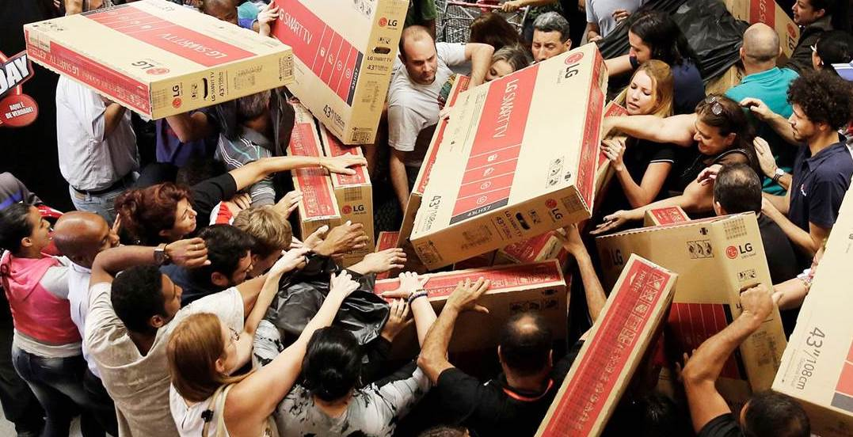
Black Friday Sales analysis & prediction
A.Priyanka
P.Anish
K.Pruthvi Raj
A.Priyanka
K.Pruthvi raj
P.Anish

Slide 2
Black Friday Sales
-> Black Friday is an informal name for the Friday following Thanksgiving Day in the United states, which is celebrated on the fourth Thursday of November.
->Analysis of normal sales is boring so lets analyse sales on the day where people literally fight for buying products on sale unlike other days.
->It can be refered to as big billion day sale on Amazon,Flipkart.
Goals
->To predict the sales of different products based on different independent variables.
->To analyse the relationship between different variables , so that we can create a model that can predict sales accurately.

Slide 3
Software used:
.Jupyter notebook
.IBM Watson
.Node-red
Modules used:
.numpy ,matplotlib , pandas ,scikit learn

Slide 4
Glimpse of data set used:
 | Product_ID | Gender | Age | Occupation | City_Category | Stay_In_Current_City_Years | Marital_Status | Product_Category_1 | Product_Category_2 | Product_Category_3 | Purchase
0 | 69042 | F | 0-17 | 10 | A | 2.0 | 0 | 3 | NA | NA | 8370
1 | 248942 | F | 0-17 | 10 | A | 2.0 | 0 | 1 | 6 | 14 | 15200
Here the dependent variable is purchase and the independent variables are everything except purchase.

Slide 5
Data set initially
Product_ID 0
Gender 0
Age 0
Occupation 0
City_Category 0
Stay_In_Current_City_Years 0
Marital_Status 0
Product_Category_1 0
Product_Category_2 141
Product_Category_3 333
Purchase 0
dtype: int64
Product_category_2,Product_category_3 contains the null values.

Slide 6
In general we can predict that there might be relation between Purchase with Gender,City_Category,Stay in current city years,Occupation,Age,Marital Status
Correlation between Numerical Predictors and Target variable
Purchase 1.000000
Gender 0.055107
City_Category 0.044914
Stay_In_Current_City_Years -0.007396
Product_ID -0.030518
Product_Category_3 -0.038411
Occupation -0.103219
Age -0.134158
Marital_Status -0.162357
Product_Category_2 -0.205563
Name: Purchase, dtype: float64
Here we can observe the positive corelations between Gender,City_category and Purchase as expected.

Slide 7
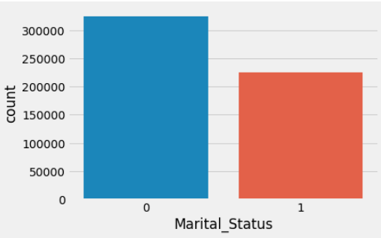
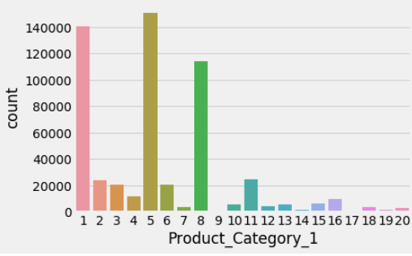
DATA VISUALIZATION
Marital Status
0-Single People 1-Married People
From the above figure it is clear that single people are buying more products on black Friday than the married people.
Product Category
From the above figure it is clear that three products stand out, number 1, 5 and 8 represents more number of buying products.

Slide 8
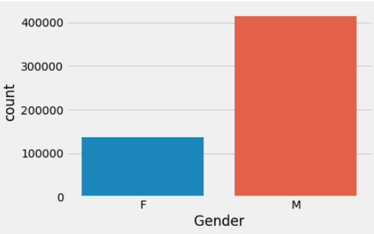
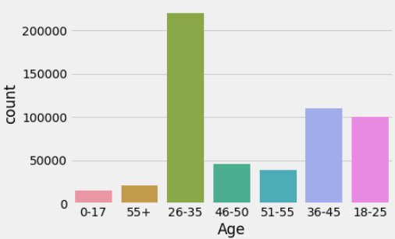
Categorical Predictors:
Non numeric variables. In this we can predict the values using bar charts ,frequency
Gender
From the above figure it is clear that Male are buying more products on black Friday than the Female.
Age
From the above figure it is clear that the peoples age between 26-35 are buying more products and the people age between 0-17 are buying less products.

Slide 9
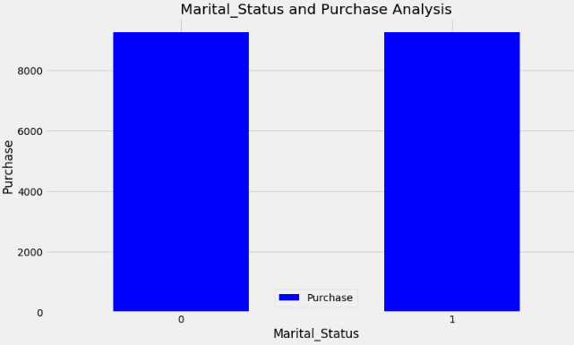
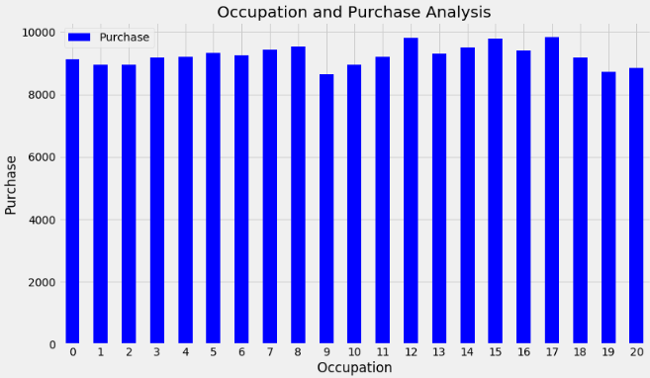
Numerical Variables
Marital status vs Sales
Occupation Vs Purchase sales
On average an individual customer tends to spend the same amount independently if his/her is married or not.
The amount each user spends on average is more or less the same for all occupations.

Slide 10
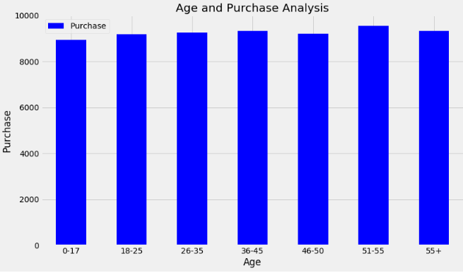
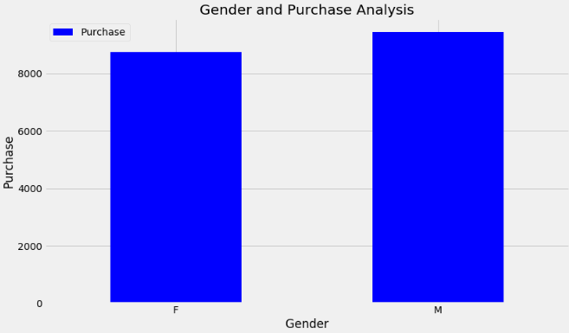
Categorical Variables
Age vs Purchase Sales
Gender vs Purchase Sales
The average spend by group age we can see the amount spent is almost the same for everyone. Curiously, on average customer with more than 50 years old are the ones who spent the most.
On average the male gender spends more money on purchase than the female

Slide 11
Data Modelling
We can train a model by using
Linear Regression
Logistic Regression
Decision Tree
SVM
Naive Bayes
kNN
Since we have many algorithms to choose from lets calculate the accuracy scores first.
Accuracy Score of Linear regression on test set 7.861742005464478
Accuracy Score of Decision Tree on test set 50.93775785935173
Since we got highest accuracy for Random Forest we used this algorithm for prediction of sales.
Accuracy Score of Random Forests on test set 63.81975515943545
These are the three highest accuracy scores that we are getting for the data taken

Slide 12
After training the random forest model with 70% of the data
These are test set data values
[ 7824, 9846, 10007, 4028, 19525, 8159, 11788, 12015, 5183, 15859, 5897, 16662, 1747, 3702, 16500, 15361, 1747, 15859, 7190, 15705, 3993, 7089, 12850, 12409, 3664, 5329, …]
These are predicted data values
[ 6078 5996 5875 1414 11023 15244 15333 16137 8702 19251 6109 15365 3580 8696 15903 15715 3696 11937 5252 11755 8007 5152 23603 5280 8621 6996 10021 7176 ,…]

Slide 13
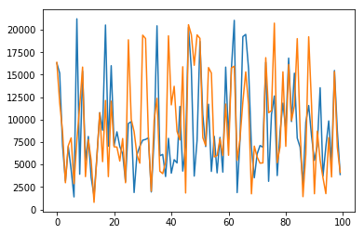
Since we cannot conclude the accuracy between them let us draw a graph
This graph shows the similarities between the test and predicted values

Slide 14
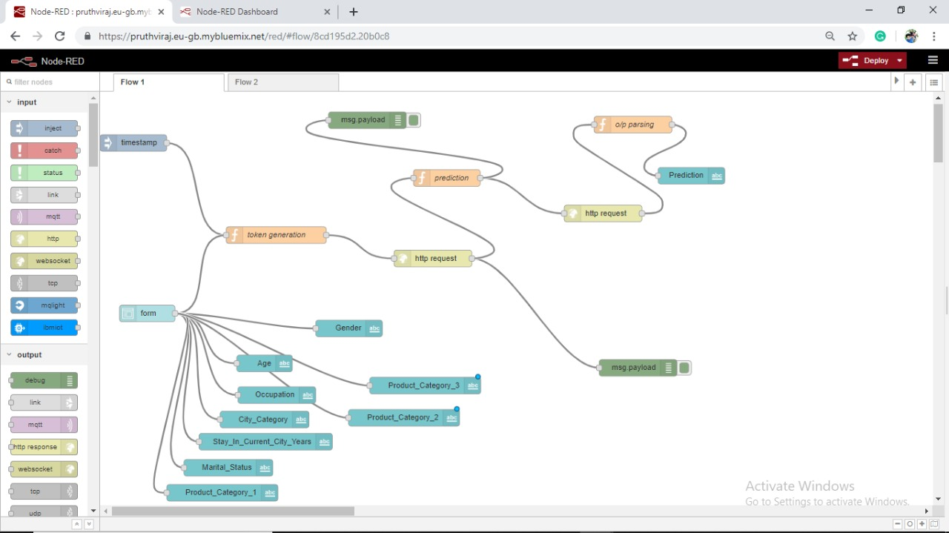

Slide 15
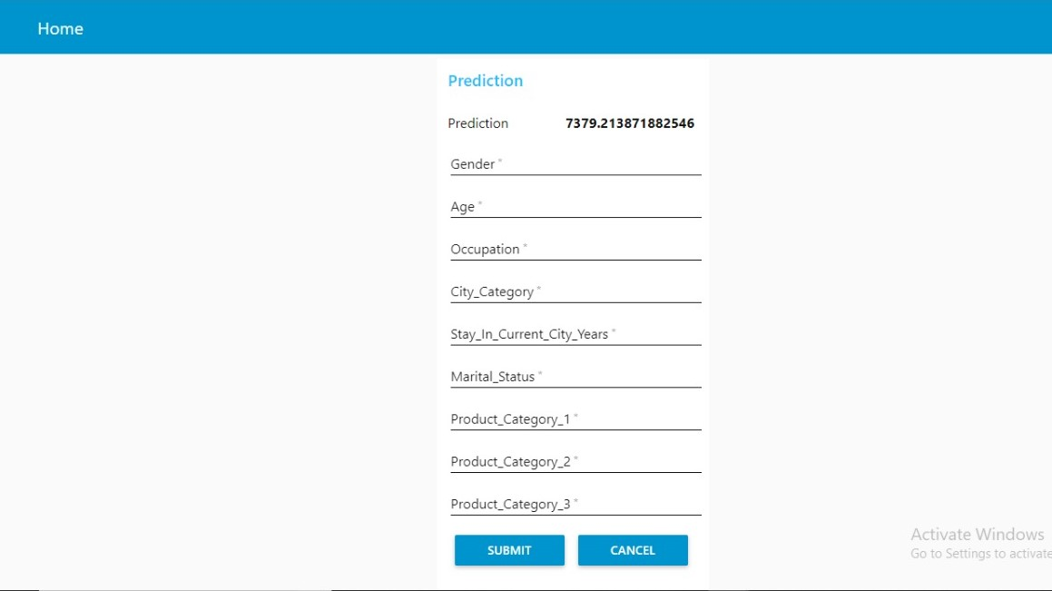

Slide 16
Findings and Suggestions
Findings:
From our exploratory data analysis we have observed the following things.
1.More single people buying products on Black Friday than married people
2.City ‘B’ had higher sales than the others instead of having lesser number of people
3. The tendency looks like the longest someone is living in that city the less prone they are to buy new things.
Suggestions:
It is suggested to decrease the discount at city B where there are more buyers and increase it at cities having less people because people are going to buy the product whatever may be the discount.this ends up giving more profits to the buyers.
Conclusion
The ML algorithm that perform the best was Random forest Model with RMSE = 4293 with accuracy of 63%

